Slide 1
Parallel and Distributed Computing
CS3006
Lecture 10
OpenMP-III

Slide 2
Review of OpenMP Clause List
Private
firstprivate, lastprivate
Shared
Default
private, shared, none
Reduction
If clause
Schedule
Static, dynamic, guided, runtime
nowait

Slide 3
Synchronization in OpenMP
Notes:
#pragma omp barrier
#pragma omp single
#pragma omp master
#pragma omp critical
#pragma omp atomic
#pragma omp ordered
#pragma omp flush[(list)]
#pragma omp threadprivate(variable list)

Slide 4
Barrier Directive
On encountering this directive, all threads in a team wait until others have caught up, and then release
#pragma omp barrier

Slide 5
Single Directive
A single directive specifies a structured block that is executed by a single (arbitrary) thread in parallel region
Implicit barrier
#pragma omp single [clause list]
structured block

Slide 6
Master Directive
The master directive is a specialization of the single directive in which only the master thread executes the structured block
No implicit barrier
#pragma omp master
structured block

Slide 7
Critical Sections (#pragma omp critical)
A Critical Section is a code segment that has a shared variable and need to be executed as an atomic action.
It means that in a group of cooperating processes/threads, at a given point of time, only one process must be executing its critical section
Forces threads to be mutex (mutually exclusive)
Only one thread at a time executes the given code section
double area, pi, x;
int i, n;
...
area = 0.0;
for (i = 0; i < n; i++) {
x += (i+0.5)/n; //can be calculated independently
area += 4.0/(1.0 + x*x); //requires mutex lock.
}
pi = area / n;
Notes:
An operation acting on shared memory is atomic if it completes in a single step relative to other threads (no other thread can observe the modification half-complete}

Slide 8
Critical Sections (#pragma omp critical)
If we simply parallelize the loop... A race condition may occur
double area, pi, x;
int i, n;
...
area = 0.0;
#pragma omp parallel for private(x)
for (i = 0; i < n; i++) {
x = (i+0.5)/n;
area += 4.0/(1.0 + x*x); //not atomic
}
pi = area / n;

Slide 9
Critical Sections (#pragma omp critical)
Race Condition
Thread A reads value of area first
Thread B reads value of area before A can update its value
Thread A updates value of area
Thread B ignores update by A and writes its incorrect value to area

Slide 10
Critical Sections (#pragma omp critical)
Race Condition
A race condition is created when one process may “race ahead” of another and overwrite the change made by the first process to the shared variable
area
15.230
Answer should be 18.995
15.432
15.230
Thread A
Thread B
area += 4.0/(1.0 + x*x)

Slide 11
Critical Sections (#pragma omp critical)
Critical section: a portion of code that only thread at a time may execute
We denote a critical section by putting the pragma #pragma omp critical [(name)]
Optional identifier name can be used to identify a critical region
Solves the problem but, as only one thread at a time may execute the statement; it becomes sequential code
double area, pi, x;
int i, n;
...
area = 0.0;
#pragma omp parallel for private(x)
for (i = 0; i < n; i++) {
x = (i+0.5)/n;
#pragma omp critical
area += 4.0/(1.0 + x*x);
}
pi = area / n;

Slide 12
Atomic Directive
The atomic directive specifies that the single memory location update should be performed as an atomic operation
#pragma omp atomic
Update instruction e.g., x++

Slide 13
Environment Variables in OpenMP

Slide 14
Environment Variables in OpenMP
OpenMP provides additional environment variables that help control execution of parallel programs
OMP_NUM_THREADS
OMP_DYNAMIC
OMP_SCHEDULE
OMP_NESTED

Slide 15
Environment Variables in OpenMP
OMP_NUM_THREADS
Specifies the default number of threads created upon entering a parallel region.
The number of threads can be changed during run-time using:
omp_set_num_threads(int threads) routine [OR]
num_threads clause → num_threads(int threads)
Setting OMP_NUM_THREADS to 4 using bash:
“ export OMP_NUM_THREADS=4 “

Slide 16
Environment Variables in OpenMP
OMP_DYNAMIC
when set to TRUE, allows the number of threads to be controlled at runtime. It means Openmp will use its dynamic adjustment algorithm to create number of threads that may optimize system performance
Incase of TRUE , total number of threads generated may not be equal to the threads requested by using the omp_set_num threads() function or the num_threads clause.
Incase of FALSE, usually total no. of generated threads in a parallel region become as requested by the num_threads clause
OpenMP routines for setting/getting dynamic status:
void omp_set_dynamic (int flag); //disables if flag=0
Should be called from outside of a parallel region
int omp_get_dynamic (); //return value of dynamic status

Slide 17

Environment Variables in OpenMP
OMP_DYNAMIC[dynamic.c]
workers = omp_get_max_threads(); //can use num_procs
printf("%d maximum allowed threads\n", workers);
printf("total number of allocated cores are:%d\n", omp_get_num_procs());
omp_set_dynamic(1);
omp_set_num_threads(8);
printf("total number of requested when dynamic is true are:%d\n", 8);
#pragma omp parallel
{
#pragma omp single nowait
printf("total threads in parallel region1=%d:\n", omp_get_num_threads());
#pragma omp for
for (i = 0; i < mult; i++)
{a = complex_func();}
}

Slide 18
Environment Variables in OpenMP
OMP_DYNAMIC[dynamic.c]
omp_set_dynamic(0);
omp_set_num_threads(8);
printf("total number of requested when dynamic is false are:%d\n", 8);
#pragma omp parallel
{
#pragma omp single nowait
printf("total threads in parallel region2=%d:\n", omp_get_num_threads());
#pragma omp for
for (i = 0; i < mult; i++)
{a = complex_func();}
}

Slide 19
Environment Variables in OpenMP
OMP_SCHEDULE
Controls the assignment of iteration spaces associated with for directives that use the runtime scheduling class
Possible values: static, dynamic, and guided
Can also be used along with chunk size [optional]
If chunk size is not specified than default chunk-size of 1 is used.
Setting OMP_SCHEDULE to guided with minimum chunk size of 4 using Ubuntu-based terminal:
“ export OMP_SCHEDULE= " guided,4" “

Slide 20
Environment Variables in OpenMP
OMP_NESTED
Default value is FALSE
While using nested parallel pragma inside another, the nested one is executed by the original team instead of making new thread team.
When TRUE
Enables nested parallelism
While using nested parallel pragma code inside another, it makes a new team of threads for executing the nested one.
Use omp_set_nested(int val) with non-zero value to set this variable to TRUE.
When called with ‘0’ as argument, it set the variable to FALSE

Slide 21

Environment Variables in OpenMP
OMP_NESTED[nested.c]
omp_set_nested(0);
#pragma omp parallel num_threads(2)
{
#pragma omp single
printf("Level 1: number of threads in the team : %d\n", omp_get_num_threads());
#pragma omp parallel num_threads(4)
{
#pragma omp single
printf("Level 2: number of threads in the team : %d\n",
omp_get_num_threads());
}
}

Slide 22

Environment Variables in OpenMP
OMP_NESTED[nested.c]
omp_set_nested(1);
#pragma omp parallel num_threads(2)
{
#pragma omp single
printf("Level 1: number of threads in the team : %d\n", omp_get_num_threads());
#pragma omp parallel num_threads(4)
{
#pragma omp single
printf("Level 2: number of threads in the team : %d\n",
omp_get_num_threads());
}
}

Slide 23
Example

Slide 24
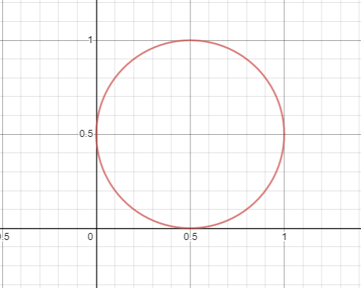
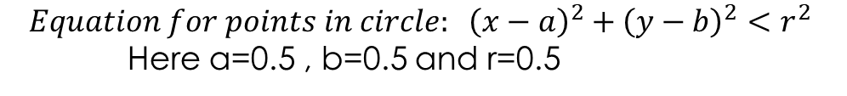

Computing Pi using Monti Carlo method
Preliminary Idea:
Pi = 4 x ($\frac{\text{points} \text{in} \text{circle}}{\text{points} \text{in} \text{square}}$)
$$Equation for points in circle: {\left(x−a\right)}^{2}+{\left(y−b\right)}^{2}<r^{2}$$
Here a=0.5 , b=0.5 and r=0.5
Notes:
Why we use mote carol simulation: we test random number generators using this method

Slide 25
Computing Pi using Monti Carlo method
Steps
For all the random points
Calculate total points in the circle
Divide points in the circle to the points in the square
Total number of points are also the total number of points inside the square
Multiply this fraction with 4
As number of random points increases, the value of Pi approaches to real value (i.e., 3.14179…..)

Slide 26
Computing Pi using Monti Carlo method
Sequential Implementation
int niter= 100000000;
count=0;
seed(time(0));
for (i=0; i<niter;++i) //10 million
{
//get random points
x = (double)random()/RAND_MAX;
y = (double)random()/RAND_MAX;
z = ((x-0.5)*(x-0.5))+((y-0.5)*(y-0.5));
//check to see if point is in unit circle
if (z<0.25)
{
++count;
}
}
pi = ((double)count/(double)niter)*4.0; //p = 4(m/n)
printf("Seq_Pi: %f\n", pi);

Slide 27
Computing Pi using Monti Carlo method (Parallel construct [parallel_pi.c])
#pragma omp parallel shared(niter) private(i, x, y, z, chunk_size, seed) reduction(+ : count)
{
num_threads = omp_get_num_threads();
chunk_size = niter / num_threads;
seed=omp_get_thread_num();
#pragma omp master
{printf("chunk_size=%ld\n",chunk_size);}
count=0;
for (i=0;i<chunk_size; i++)
{
//get random points
x = (double)rand_r(&seed)/(double)RAND_MAX;
y = (double)rand_r(&seed)/(double)RAND_MAX;
z = ((x-0.5)*(x-0.5))+((y-0.5)*(y-0.5));
//check to see if point is in unit circle
if (z<0.25)
{
++count;
}
}
}
pi = ((double)count/(double)niter)*4.0;

Slide 28
Parallelizing linked lists
Consider the following code:
current=head;
while(current->next != NULL){
complex_func(current->key); //complex consumer func
current=current->next;
}
Assume that complex function can be computed foreach key value independently
The code can’t be parallelized directly as:
We don’t have omp constructs to parallelize while loops and equivalent for loop don’t have canonical form.
This is because we don’t know number of iterations in advance
If we simply put ‘omp parallel pragma’ before while, program semantics will not be assured

Slide 29
Parallelizing linked lists [Naïve idea:1 with logical error]
Consider the following code:
current=head;
#pragma omp parallel firstprivate(current)
{
while(current-> next != NULL){
complex_func(current->key); //complex consumer func
current=current-> next;
}
}
Creates team of threads, each with private ‘current’ variable.
Each thread will execute for all the nodes in the list
This means every thread will perform work equal to sequential code
No speedup achieved, this will rather increase execution time

Slide 30
Parallelizing linked lists [Naïve idea:2 with logical error]
Consider the following code:
current=head;
#pragma omp parallel shared(current)
{
while(current-> next!=NULL){ //line 1
complex_func(current->key); //complex consumer func
current=current-> next; //line 3
}
}
Creates team of threads sharing same ‘current’ variable.
For first while iteration, complex_func may be called by each thread with same key-value.
Semantics/atomics will not be ensured (i.e., multiple threads executing line-3 can change line-1 result for other threads)
So, output may not be as assumed

Slide 31
Parallelizing linked lists [Naïve but Correct parallelization]
Observations:
We don’t know in advance the number nodes in the list
We also don’t know how to access all the nodes parallelly from the list. This because the linked-list can only be accessed sequentially
We can parallelize it using the following steps
Count number of nodes in the list →call it ‘C’
Allocate a dynamic array of pointers-to-list of size ‘C’. Now using loop, copy address of ith node to the ith element in the pointers-array.
Now we can use for-loop that can iterate on this array of pointers. Furthermore, this for-loop can also be parallelized

Slide 32
Parallelizing linked lists [Naïve but Correct parallelization]
Count number of nodes in the list →call it ‘C’
//struct LIST{ int key; LIST* ptr; } list;
int C=0; LIST *p =head;
//Here assume head is pointer to the start of the list.
while(p != NULL){
p=p->next;
C++;
}

Slide 33
Parallelizing linked lists [Naïve but Correct parallelization]
Allocate a dynamic array of pointers-to-list of size ‘C’ and using loop, copy address of ith node to the ith element in the pointers-array
LIST **Parray = new LIST* [C];
p =head;
while(p != NULL){
Parray[i]=p;
p=p->next;
}

Slide 34
Parallelizing linked lists [Naïve but Correct parallelization]
Now we can use for-loop that can iterate on this array of pointers. Furthermore, this for-loop can also be parallelized
#pragma omp parallel for schedule(static,1)
for(i=0;i<C;i++){
complex_func(Parray[i]->key);
}
This method can result in speedups only if tasks are complex enough to overcome the data-movement costs.
Usually, data-movements are more costly than the computations
So, we need to devise another solution

Slide 35

Parallelizing linked lists [A relatively better implementation ]
//omptask.c and tasktime.c //execute using g++
#pragma omp parallel
{
#pragma omp single //single process will go into the region
{
current=head;
while(current->ptr!=NULL){
//following line creates a task and adds to logical task pool.
#pragma omp task firstprivate(current)
complex_func(current->key);
current = current->ptr;
}
}
}
Total threads=4
Total complex itters= 100 Million
List size= 10 nodes
Notes:
https://www.youtube.com/watch?v=mNPmylnhYYQ&list=PLLX-Q6B8xqZ8n8bwjGdzBJ25X2utwnoEG&index=22
, the other threads start processing the tasks as they become available

Slide 36
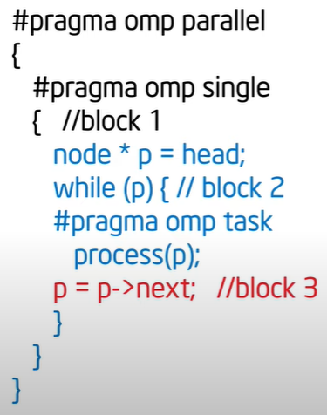
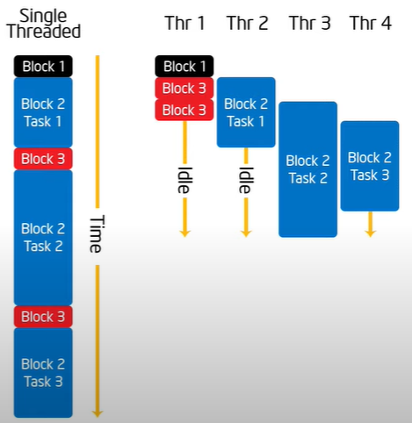
Parallelizing linked lists [omp task illustration]

Slide 37

Questions

Slide 38
References
Kumar, V., Grama, A., Gupta, A., & Karypis, G. (2017). Introduction to parallel computing. Redwood City, CA: Benjamin/Cummings.

